Slide 1
Foundations of Software Testing
Types of testing : Functional vs non functional, static vs dynamic, manual vs automated
Week 4

Slide 2
Introduction to Types of Testing
Testing is classified based on:
Objective (Functional vs. Non-Functional)
Execution Approach (Static vs. Dynamic)
Test Levels (Unit, Integration, System, Acceptance)
Methodology (Manual vs. Automated)

Slide 3
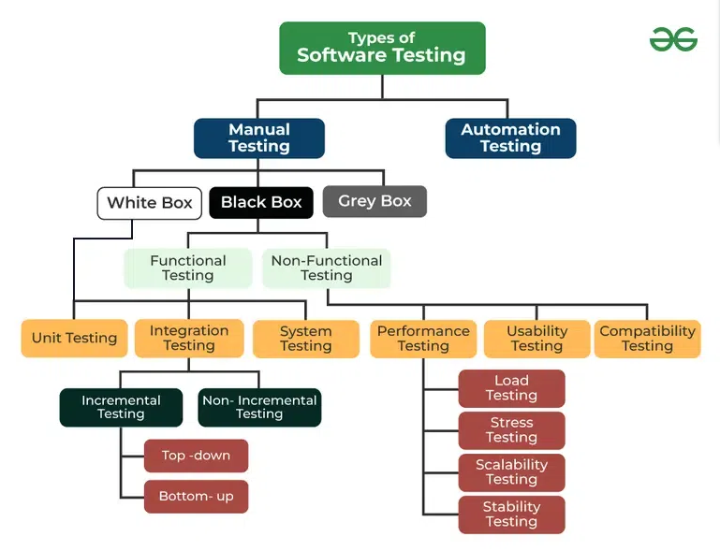
Types of Testing

Slide 4
Functional Testing
Definition: Ensures that the system functions as per specified requirements.
Why Functional Testing?
Identifies missing functionalities.
Validates expected outcomes.
Ensures compliance with business needs.

Slide 5
Functional TESTING TYPES
Unit Testing:
Unit Testing is the process of testing individual components or functions of a system in isolation.
Ensures that each function/method works correctly.
Helps in catching bugs early in development.
Integration Testing
Integration Testing verifies that different modules of the application work together as expected.
Ensures that different modules interact correctly.
Detects issues in data flow, APIs, or database interactions.

Slide 6
System Testing
System Testing tests the entire application as a complete system to verify that it meets functional and technical requirements.
Validates the end-to-end workflow of the application.
Ensures all components work together under real-world conditions.
User Acceptance Testing (UAT)
User Acceptance Testing (UAT) is the final phase of testing, where real users validate whether the software meets business needs.
Ensures the software solves real-world problems for users.
Checks for usability, compliance, and business requirement fulfillment.

Slide 7
Non-Functional Testing
Definition: Focuses on aspects like performance, security, usability, and compatibility.
Why Non-Functional Testing?
Ensures the software is efficient and secure.
Enhances user experience and reliability.
Validates performance under various conditions.

Slide 8
Types of Non-Functional Testing:
Performance Testing:
Measures the speed, scalability, and responsiveness of the system.
Includes:
Load Testing: Evaluates system behavior under expected user load.
Stress Testing: Determines the system’s stability under extreme conditions.
Soak Testing: Assesses system performance over an extended period.
Security Testing:
Identifies vulnerabilities and ensures data protection.
Includes penetration testing and ethical hacking.

Slide 9
Types of Non Functional Testing:
Usability Testing:
Evaluates the system’s ease of use and intuitiveness.
Ensures user-friendly design and navigation.
Compatibility Testing:
Checks system behavior across different devices, browsers, and operating systems.
Ensures cross-platform consistency.
Reliability Testing:
Assesses system stability over time.
Determines failure recovery mechanisms.

Slide 10
Static vs. Dynamic Testing
Static Testing:
Testing without executing the code.
Identifies defects early in the software development lifecycle.
Includes:
Reviews: Code reviews, walkthroughs, and inspections.
Static Analysis: Automated tools for detecting syntax errors,
coding standards violations, and security vulnerabilities.
Benefits:
Detects issues before execution, reducing cost.
Ensures compliance with design and documentation standards.
Improves maintainability by enforcing coding best practices.

Slide 11
Dynamic Testing:
Testing by executing the code to observe system behavior.
Identifies defects related to runtime conditions and interactions.
Includes:
Unit Testing: Testing individual components in isolation.
Integration Testing: Checking interactions between different modules.
System Testing: Verifying end-to-end system functionality.
Acceptance Testing: Ensuring the system meets user expectations.
Benefits:
Identifies real-time performance and security issues.
Provides feedback on actual system behavior.
Ensures functional correctness of the software.

Slide 12
Manual vs. Automated Testing
Manual Testing:
Performed by human testers without automation.
Best for:
Exploratory Testing: Testers actively explore the application.
Usability Testing: Evaluates user experience and accessibility.
Ad-hoc Testing: Random, informal testing without predefined test cases.
Advantages:
Allows human intuition to detect UI/UX issues.
Flexible for complex test cases.
Disadvantages:
Time-consuming and labor-intensive.
Prone to human errors.

Slide 13
Automated Testing:
Uses scripts and testing tools to execute test cases.
Best for:
Regression Testing: Repeated tests after updates.
Load & Performance Testing: Simulates high user traffic.
Data-Driven Testing: Runs multiple test scenarios with different inputs.
Advantages:
Faster execution and higher accuracy.
Supports continuous integration and delivery (CI/CD).
Disadvantages:
Requires initial investment in tools and scripting.
Not suitable for UI/UX and exploratory testing.

